Slide 1
Path Finding Visualization Sahil Rajgadkar-111803180
BFS, DFS, A*

Slide 2
BFS- Breadth First Search
BFS starts from the root node, explores the neighboring nodes first and moves towards the next level neighbors. It generates one tree at a time until the solution is found. It can be implemented using FIFO queue data structure. This method provides shortest path to the solution.
>Advantages
-Always finds optimal solutions.
-There is nothing like useless path in BFS, since it searches level by level.
>Disadvantages
-When the search space is large the search performance will be poor compared to other heuristic searches
-Since each level of nodes is saved for creating next one, it consumes a lot of memory space. Space requirement to store nodes is exponential.
>Applications
-Copying garbage collection, Cheney's algorithm
-Testing bipartiteness of a graph.

Slide 3
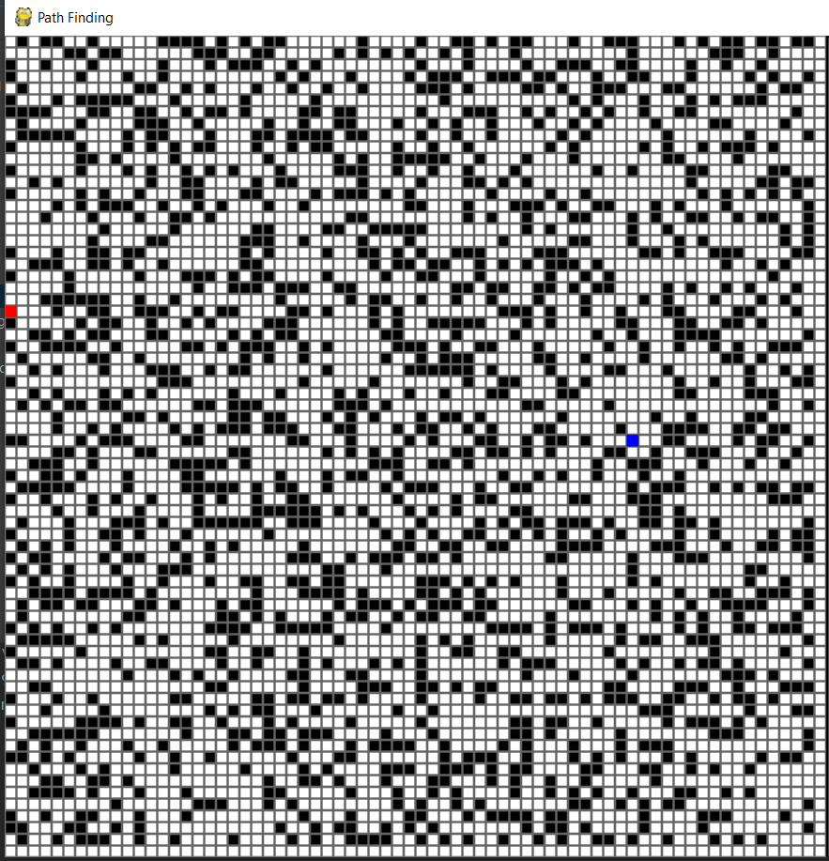
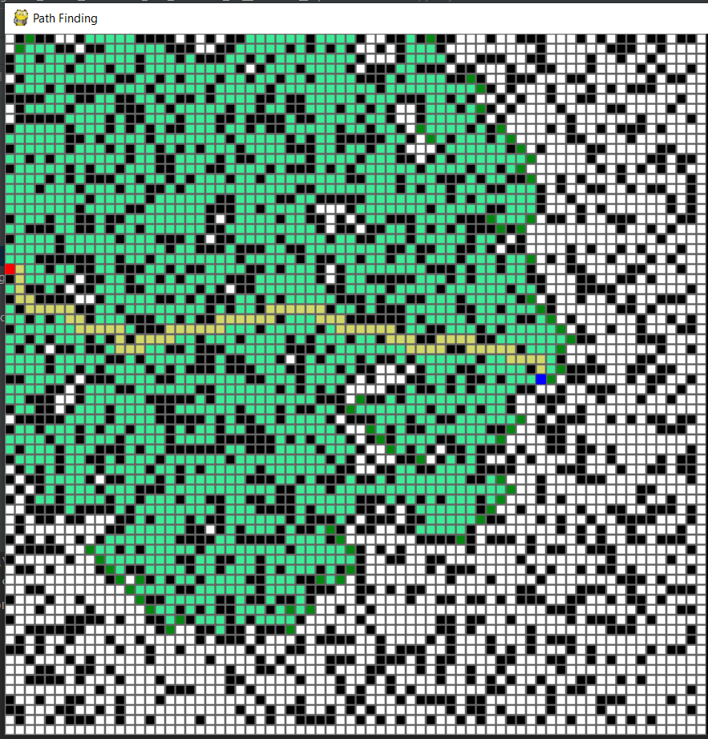
BFS

Slide 4
DFS-Depth First Search
Depth-first search (DFS) is an algorithm for traversing or searching tree or graph data structures. The algorithm starts at the root node (selecting some arbitrary node as the root node in the case of a graph) and explores as far as possible along each branch before backtracking.
>Advantages
-It will reach at the goal node in a less time period than BFS if it traverses in a right path.
-DFS consumes very less memory space.
>Disadvantages
-It does not guarantee shortest path
-DFS algorithm may not terminate and go on infinitely on one path
>Application
-Solving puzzles with only one solution, such as mazes.
-Maze generation may use a randomized depth-first search.
-Finding connected components.

Slide 5
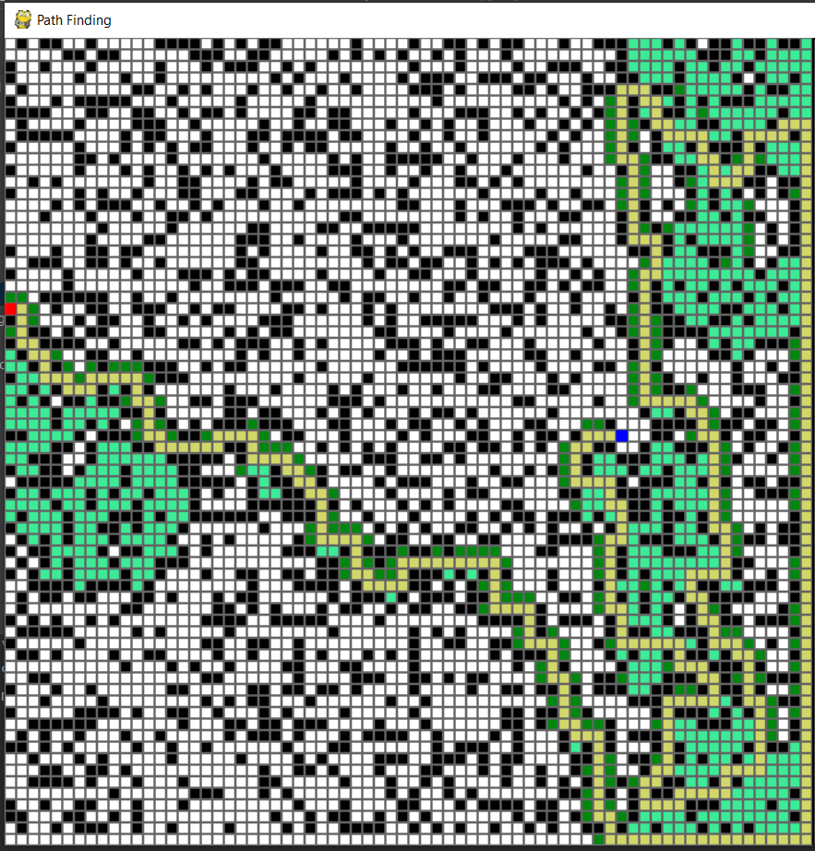
DFS

Slide 6
A Star
A* is an informed search algorithm, formulated in terms of weighted graphs: starting from a specific starting node of a graph, it aims to find a path to the given goal node having the smallest cost (least distance travelled, shortest time, etc.). It does this by maintaining a tree of paths originating at the start node and extending those paths one edge at a time until its termination criterion is satisfied.
>Advantages
-It is complete and optimal.
-It is the better from other techniques used.
>Disadvantages
-A* Search Algorithm doesn’t produce the shortest path always, as it relies heavily on heuristics / approximations to calculate – h
-The speed of execution of A* search is highly dependant on the accuracy of heuristic algorithm that is used to compute h(n)
>Application
-A* is often used for the common pathfinding problem in applications such as video games. It finds applications in diverse problems, including the problem of parsing using stochastic grammars in NLP. Other cases include an Informational search with online learning.

Slide 7
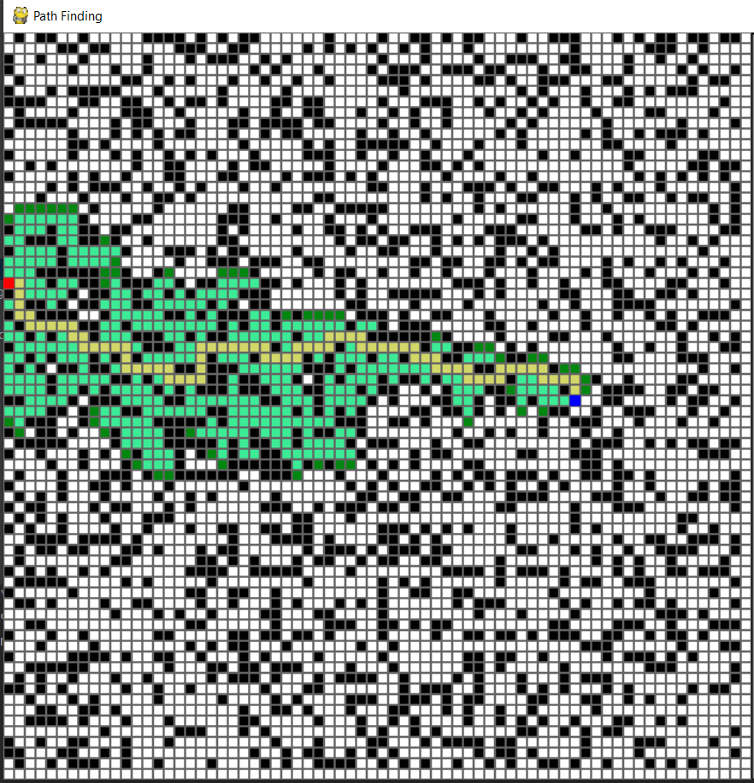
A Star

